Slide 1

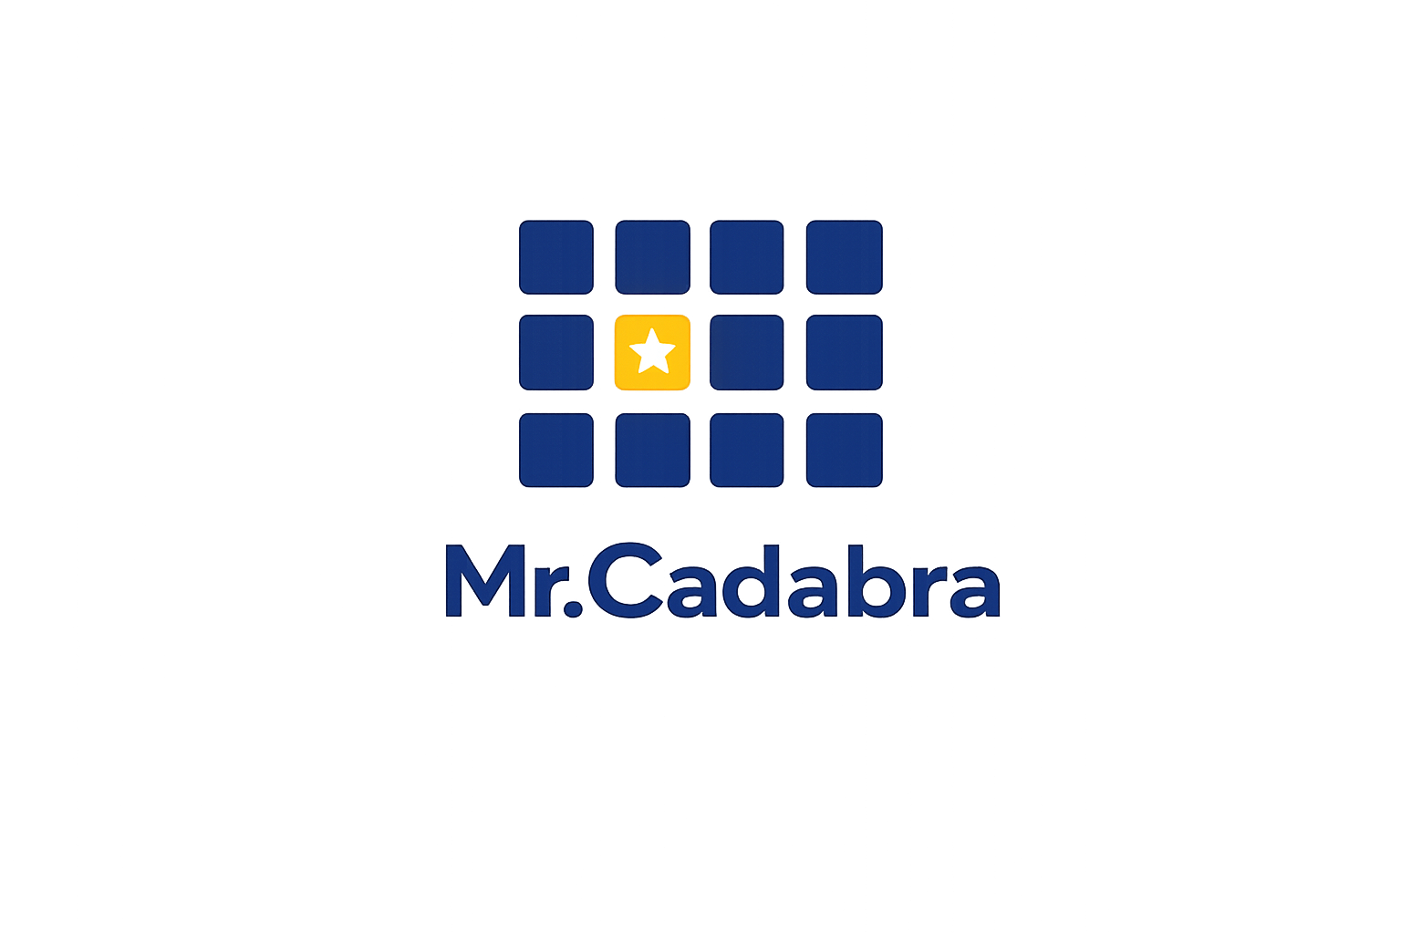
FOR TEACHERS • CO-OPS • MICROSCHOOLS
— AI-Powered Tutor —
Math Tutoring for Every Student
Complete Classroom Insight for Every Teacher
mrcadabra.com
Notes:
If you teach math to more than one student — a co-op, a microschool, or a classroom — see how Mr. Cadabra provides personalized tutoring for each student while you keep the big-picture view of the class.
**Slide 1 — See your whole class at a glance.** If you teach math to more than one student — a co-op, a microschool, or a classroom — here's what Mr.Cadabra looks like from the front of the room. **Slide 2 — Every student, tutored one-on-one.** Every student in your class gets the same patient one-on-one tutor, working at their own placed level. That means intervention without stigma — a ninth grader can quietly rebuild fractions without ever seeing a grade level on screen. **Slide 3 — The mastery heatmap.** This is your classroom view: the mastery heatmap. Every cell is a student's best real check score on a unit — gold stars mean mastered. And "needs attention" names the unit your whole class is weakest on, so you know exactly what to reteach. **Slide 4 — Drill into any student.** Click any name and you get that student's full dashboard — their units, their accuracy, their streak, and honest time-on-task where idle minutes never count. It's the picture you'd build by hand, already built. **Slide 5 — Built for real classrooms.** It's built for the realities of a classroom. You add students by code — no student emails, no new personal data. There are no microphones to manage; headphones are all you need. And the built-in course assessment maps each student's strengths for you. **Slide 6 — Pilot it free this term.** We're partnering with a limited number of classrooms this term: you get Mr.Cadabra free for the pilot, we get your honest feedback. Email support@mrcadabra.com and tell us about your class.

Slide 2

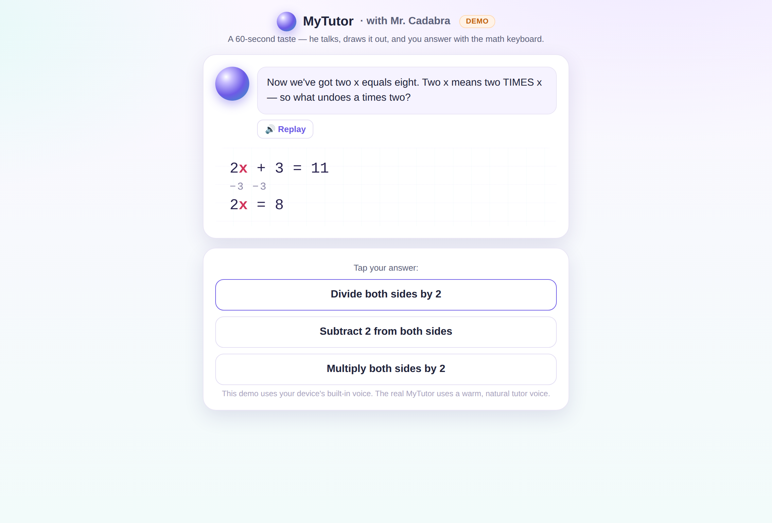
Every student is tutored one-on-one
Mr. Cadabra, your AI-powered math tutor, teaches each student individually — out loud, Socratically, at their own pace.
Notes:
Every student in your class gets the same patient one-on-one tutor, working at their own pace. That means intervention without stigma.

Slide 3

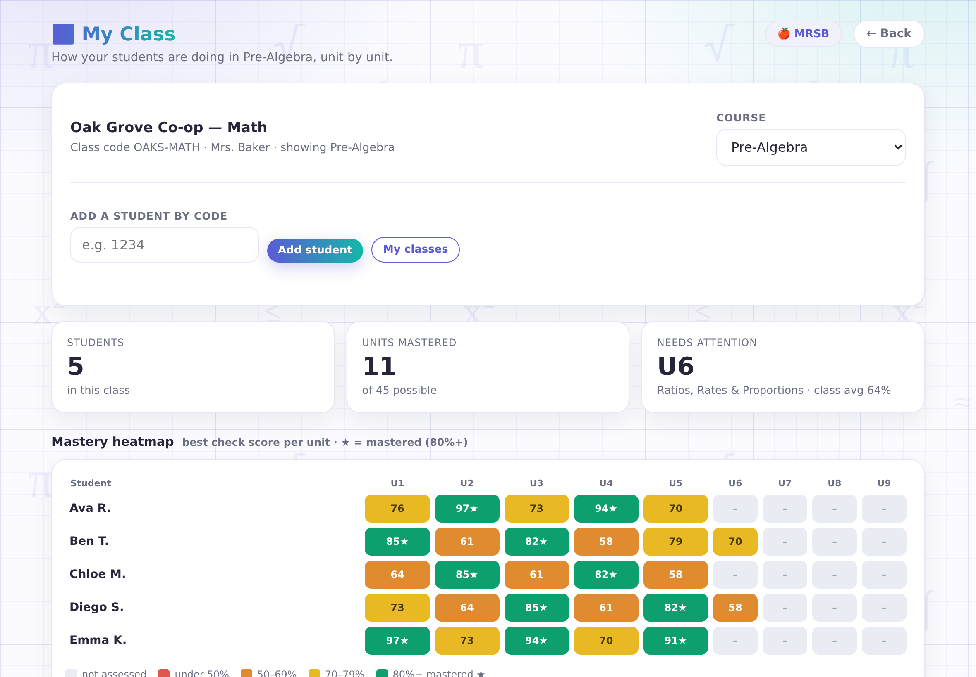
The mastery heatmap
Best check score per unit, for each student.
"Needs attention" names the unit your class is weakest on.
Real scores, not participation points.
Notes:
This is your classroom view: the mastery heatmap. Every cell is a student’s best score on a unit. ‘Needs attention' names the unit your whole class is weakest on, so you know exactly what to reteach.

Slide 4

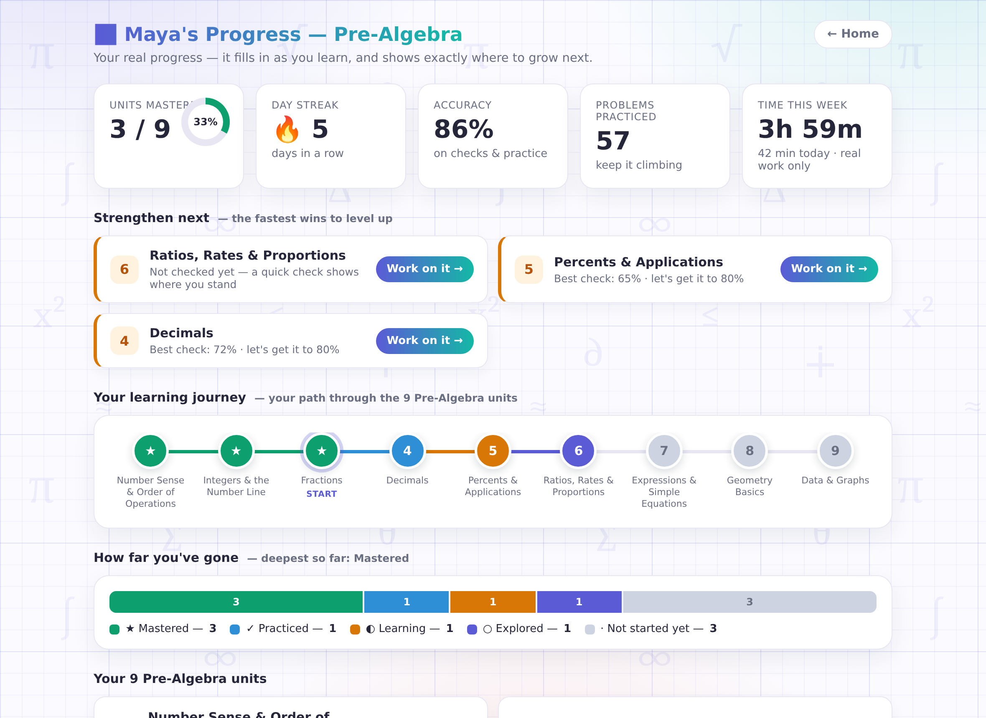
Drill into any student
One click opens any student's full dashboard: units, accuracy, streak, time on task.
The built-in course assessment maps each student's strengths for you.
Notes:
Click any name, and you get that student's full dashboard — their units, their accuracy, their streak, and time-on-task where idle minutes never count.

Slide 5



Built for Real Classrooms
📋
Roster by code
📝
Assessments included
No voice recording kept
The tutor talks; students type or click. Headphones are all your room needs.
Add students with their login codes — no student emails, no new personal data collected.
A friendly course assessment maps each student's strengths and recommends a path.
Notes:
It's built for the realities of a classroom. You add students by code — no student emails, no new personal data. There are no microphones to manage; headphones are all you need.

Slide 6
Pilot it for free now
— AI-Powered Tutor —
Try Mr.Cadabra for free this term and provide us with your valuable feedback to help us improve.
Send a request to:
support@mrcadabra.com
Notes:
We're partnering with a limited number of classrooms this term: you get Mister Cadabra free for the pilot, we get your honest feedback. Email support at Mister Cadabra dot com and tell us about your class.

